Slide 1
GIVING COMMENTS TO THE NEWS
Ninth Grader
JUNIOR
Abdul Aziz, S.Pd. And Asep Sunandar, S.Pd.

Slide 2
Contents
Giving Comments to News
1
Good News
2
Congratulations
3
Bad News
3
4
Wishes/Hopes
4

Slide 3

Hot Tip
These expressions are used to comment to good news:
It’s good that she got the score seeing that she studied hard last semester
She must have studied hard for this lesson
What? That’s the best news I ever had
That’s great
Get real!

Slide 4

Hot Tip
What Is an Expression of Congratulations?
Expression of Congratulations is an expression that we use give the
congratulation utterance when he or she be succeed in doing something
Good News:
Guess what? I won a badminton Championship.
I get a scholarship from the local government!
Congratulating:
That’s great! Congratulations.
Wow! Congratulations.

Slide 5

Hot Tip
These expressions are used to give comments to bad news:
This lesson must have been very hard for her
Poor Janet. She mustn’t have done it
He must be very sad now
That’s very bad

Slide 6

Hot Tip
These expressions are used to wish/hope to someone
Wish all the best
I wish you luck
I hope it’ll be alright
My hope is...

Slide 7

ASSIGNMENT
Discuss the following questions.
Is the boy happy or sad? Why?
If the boy is your friend, what will you say to him?
Have you ever experienced the same situation? When or where?
How do your friends give comment to you when you get good news?

Slide 8
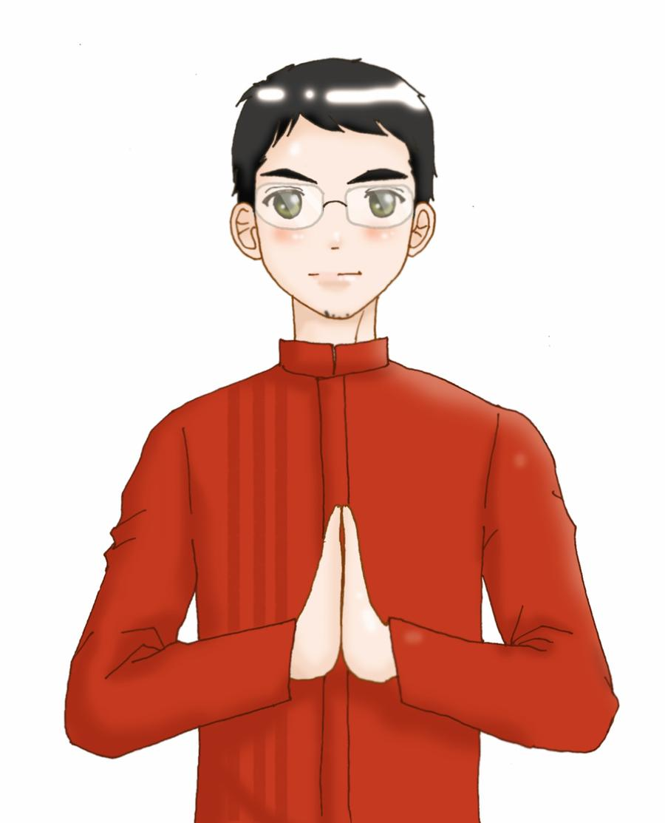
Thank You
Any question?

